Slide 1
Analysis, Design and Implementation
Topic 3:
Object-Oriented Modelling
Notes:
NCC Education - Title Master

Slide 2
Scope and Coverage
This lecture will cover:
  The OOAD development process
  An overview of previous methods
  The benefits of OOAD
  The drawbacks to OOAD
Notes:
NCC Education - Slide Master

Slide 3
Introduction
  In this lecture we are going to address the way in which the OOAD process is applied.
  We are also going to talk about what came before a little.
  OOAD as a process has many benefits.
    And the object-oriented programs it inspires are the norm for the industry.
  It also has a number of drawbacks.
    We will discuss these too.

Slide 4
In the Past...
  In the past, most analysis and design progressed through the use of two systems.
    Structured Systems Analysis and Design (SSADM)
    The Waterfall Model
    (We touched on this briefly during the first lecture.)
  As software systems grew in size and complexity, these tools ceased to scale up.
  In addition, they were somewhat difficult to change to adapting circumstances.

Slide 5
SSADM
  SSADM stressed a ‘data-oriented’ approach to developing diagrams for systems.
    Most of the diagramming was done through data flow diagrams (DFDs)
  These emphasised the way in which data was stored, manipulated and passed through the system.
  It was a useful notation, but as systems grew so too did the diagrams.

Slide 6
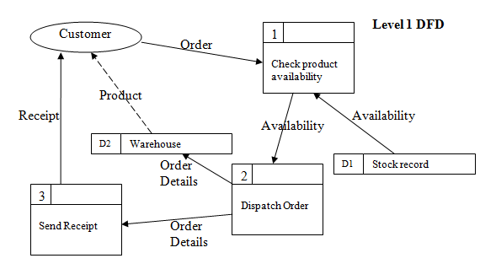
Example DFD

Slide 7
Data Flow
  Each of the boxes in the level one DFD would be expanded into a DFD of its own, and so on.
  Rapidly, it became difficult to explore a complex program while also understanding the context in which parts functioned.
  Because of the focus on data, documents had to be maintained defining what data was and where it was used.

Slide 8
Data Dictionaries
  These were called data dictionaries, and it was not uncommon for them to run to hundreds of pages.
  They stored details of formats, defaults, validation routines, and so forth.
  Any time data was used, its use was recorded in the dictionary.
  Any time new data was generated, it was recorded in the dictionary.
  It was very unwieldy.

Slide 9
Software Complexity
  As the complexity of software increases, these diagrams became more cumbersome.
  Object-oriented analysis and design was introduced to help simplify the architecture of large, complex programs.
    An object is a small, self-contained program of its own.
    The system is the interaction of all the objects in a program.
  This allows for more compact representation in diagrams.

Slide 10
Object-Orientation
  Object-orientation is a progression from the procedural programming paradigm of earlier languages.
    Objects add an extra level of modularity on top of the existing functions permitted.
  Programs written using structured programming often lacked maintainability.
  Object-orientation was developed to address this deficiency.

Slide 11
Benefits of OOAD
  Object-oriented analysis and design has a number of advantages over structured analysis and design:
  Systems are more effectively decomposed into units.
  Good OOAD results in components that are more easily maintained.
  Good OOAD results in components that can be more easily reused between systems.
  OOAD more naturally models how systems work in practise.
    Data flow analysis is an artificial, algorithmic overview.

Slide 12
Drawbacks of OOAD
  There are drawbacks too:
  Large systems will have hundreds of classes, and interactions can be complicated.
  It is easy to badly design classes.
  Object-orientation requires a trade-off between coupling and cohesion - you cannot have it all.
  While it more naturally models how systems work, it is still an unusual way for people to think.

Slide 13
A Simple OOAD Process - 1
  Much of the benefit of OOAD can be obtained through the use of a five step process.
    Identify the needs of users
    Documented via use case diagrams
    Detail the steps needed for each of the requirements
      Done through activity diagrams
    Decompose the requirements for the system
      Break it down into components via class diagrams
    Define out the interactions
      Bring it all together in a component diagram
    Iterate

Slide 14
A Simple OOAD Process - 2
  Iteration is an important part of OOAD.
    You will never get it right the first time.
    New requirements and information will be introduced all the time.
  Incremental analysis and design is simplest.
    Do not try to solve the whole problem at once.
    Pick a starting point, and work from that.
  Good design is user centric.
    You need to know what the users have to say.

Slide 15
Decomposition
  Understanding any complex system is an exercise in decomposition.
    You must be able to partition the whole into manageable subsections.
  Abstraction is an important part of this process.
    You need to be able to view the different parts at a suitable level of granularity.
  Incremental development is the process of successively refining your abstractions.

Slide 16
The Use Case Diagram - 1
  The Use case diagram is an important tool in managing your abstractions. It allows you to represent the broad interactions between parts of a system.
  It is used to represent the set of functionality that must be supported for each part. Those parts are called actors.
    They may be users.
    They may be subsystems.

Slide 17
The Use Case Diagram - 2
  Use case diagrams do not show interactions between actors. That is beyond the scope of our analysis and design.
  Actors are represented by stick figures.
  Actions are represented by ovals in which a broad description of the process is placed.
  A specific interaction is defined as a line which connects the actor and the action they can perform.

Slide 18
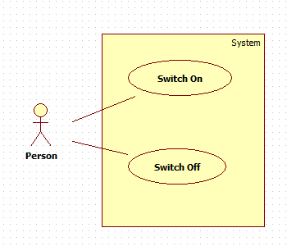
Use Case Diagram Example 1

Slide 19
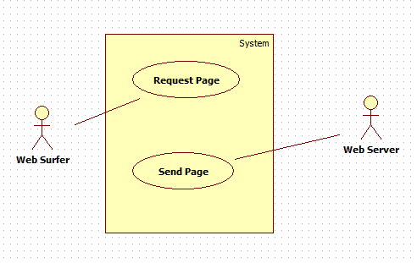
Use Case Diagram Example 2

Slide 20
Use Case Diagrams
  Use case diagrams are supposed to show only broad strokes of interaction.
  However, sometimes we want to specialise a specific action if it has clearly defined subtasks.
  To do this we create a separate diagram and flesh out the interaction.
    We can make an interaction have multiple parts, providing a <<uses>> line to indicate subtasks.

Slide 21
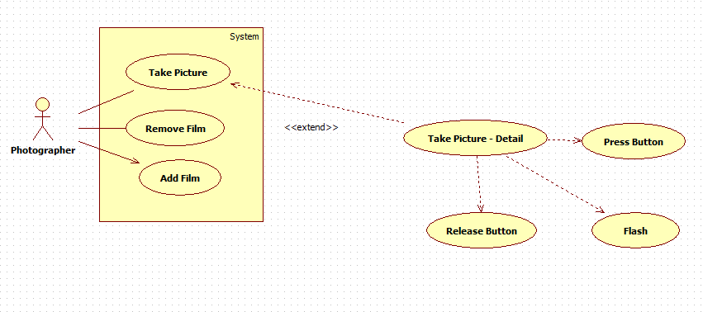
Use Case Diagram Example 3

Slide 22
Use Case Diagrams - 2
  Note that no order is imposed in use diagrams. We will handle that in a different, later diagram.
  You can think of this as a high level overview of your user interface.
    You need to permit ways for people to do all of the things you have indicated on the diagram.
  Generating the use case diagram will be a result of interaction with the users and the problem statement.

Slide 23
Use Case Diagrams - 3
  A third special syntax of a use case diagram permits you to indicate that one kind of action derives from another.
  This is the extends syntax, and is used to demonstrate both inheritance and polymorphism in a diagram.
    You will not have to do this until quite late into the OOAD process.

Slide 24
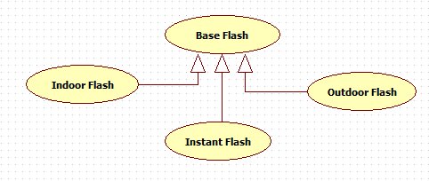
Use Case Diagram Example 4

Slide 25
Identifying Use Cases - 1
  We can use a technique called event decomposition to arrive at a list of candidate events for our system.
    We treat the system as a black box.
    We focus on the things that happen to the black box.
  We may end up discarding or combining the events that we come up with.
    That is all part of the iterative process.
    What we need to begin with is a starting point.

Slide 26
Identifying Use Cases - 2
  There are three main kinds of event we need to look at.
    External events
    Temporal events
    State events
  We consider each of these events in relation to the potential actor.
    This technique is merely a way of focusing our thinking.
    The starting point will still be the problem statement or the users.

Slide 27
External Events
  External events exist outside the system, and are usually initiated by a third party outside the scope of our system, for example, the customer of a web page, or the database administrator.
  We then document all of the potential interactions that each of these actors may be required to perform. Each of these then becomes a candidate for a use case diagram.

Slide 28
Example Candidates
Customer | List products by category List products by price Buy a product Read reviews of a product View shopping basket Update account details
Administrator | Add new products Remove products Modify products Modify customer details

Slide 29
Temporal Events - 1
  Temporal events are those that occur as a result of reaching a particular point in time, for example ‘End of the month, so handle salaries.’
  Sometimes these events will be triggered by external entities. A user may set up an report that should be mailed to them every week.
  We determine temporal events by detailing any specific deadlines or recurring functionality.

Slide 30
Temporal Events - 2
  Temporal events do not necessarily occur at a fixed time. They may instead occur after time passed.
    E.g. Debit the customer’s account ten minutes after they have purchased an item.
  The occurrence of the timed event is the temporal aspect. Setting the event to occur is often an external event.

Slide 31
State Events
  State events are those that occur when the data in a system reaches a point where processing is required.
    E.g. When stock drops below a certain amount, email the procurement department.
  Normally these occur as a result of other events.
    Temporal or state
    A customer buys a product, which adjusts the stock, which throws up a state event.

Slide 32
Choosing between Events
  What we get out of this is a list of candidates. They are not all going to be worthwhile.
  The only ones we care about are those that directly affect our system.
  We do not care about the events that lead up to the interaction, or those that follow them.
  We need to strive for a consistent level of detail across the events. This may involve breaking some out into multiple events, or combining others.

Slide 33
Conclusion
  OOAD is an evolution from structured analysis and design.
  It stresses interaction of components rather than the flow of data between algorithms.
  Use case diagrams are used to represent a high level view of actor interactions.
  There are many ways to develop use case diagrams.
    Event decomposition can be a useful technique.

Slide 34
Terminology
  Use Case Diagram
    A diagram used to represent high-level interactions with a system.
  Event decomposition
    Identifying events that must be represented in the system through analysis of raised events.
  Actor
    Something that interacts with our system. Can be external (such as a user), or a subsystem.

Slide 35
Topic 3 – Object-Oriented Modelling
Any Questions?
Notes:
NCC Education - End Slide Master

